Slide 1
MSDS 6306 DDS Case Study 2
Marc Carter
Exploratory Data Analysis

Slide 2

What is and what causes attrition at a company?
What is attrition?
Attrition is the willful reduction in staff either voluntary or involuntary. What this means is when people leave the company the company chooses not to replace them.
What causes attrition?
Attrition is caused by many factors, but it really can be answered in two further questions. Why do people leave? And why do companies not replace them. For this exercise we will focus on Why do people leave a company?

Slide 3
Why do people leave a company?
Work-Life Balance
How many extra hours are needed to complete tasks? (Cannot calculate with current data).
Days worked per month? (Cannot calculate with current data).
Does the position require overtime? (OverTime)
Does the position require a lot of travel? (BusinessTravel)
How far from home is the office? (DistanceFromHome)
How does the employee feel about the work-life balance? (WorkLifeBalance)
Work-Life Balance Score
Score is calculated in such a way to provide a value from 1 – 10. With 10 being an ideal work life balance. (i.e. working 40 hours a week and 5 days a week, little time away from home, short commute).

Slide 4
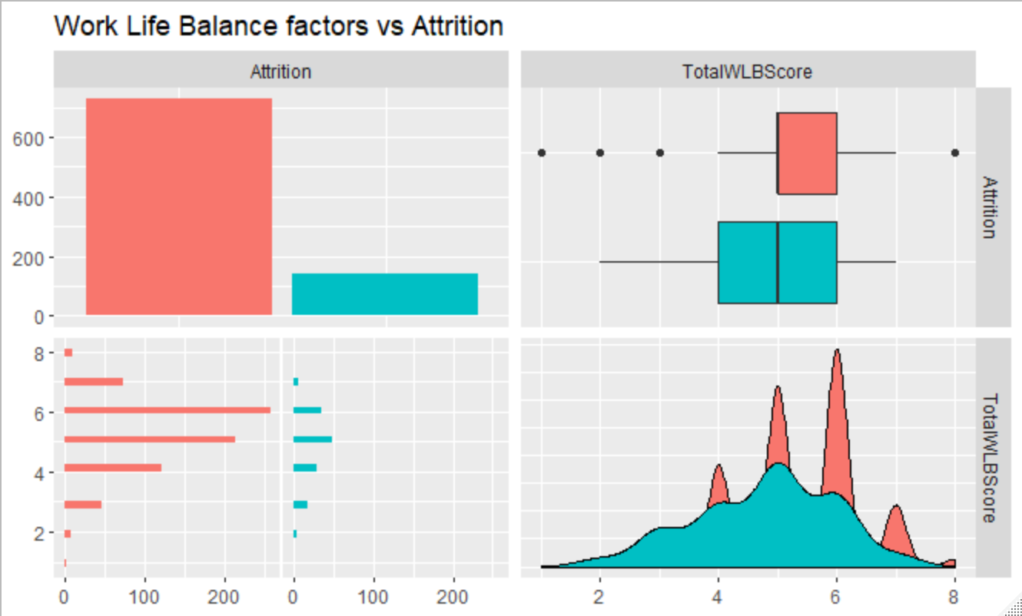
Work-Life Balance

Slide 5
Why do people leave a company?
Poor Leadership / Work Environment
Does the employee feel satisfied and comfortable in the work environment? (EnvironmentSatisfaction)
Does the employee feel like they contribute. (JobInvolvement)
Does the employee feel challenged and satisfied with the tasks assigned to them? (JobSatisfaction)
Is the employee satisfied with their manager? (RlationshipSatisfaction, YearsWithCurrManager)
Environment Score
The environment score gauges the employee’s satisfaction in their workplace and with the management of their position. A high score means they are likely happy with the environment and the leadership, and therefore less likely to leave.

Slide 6
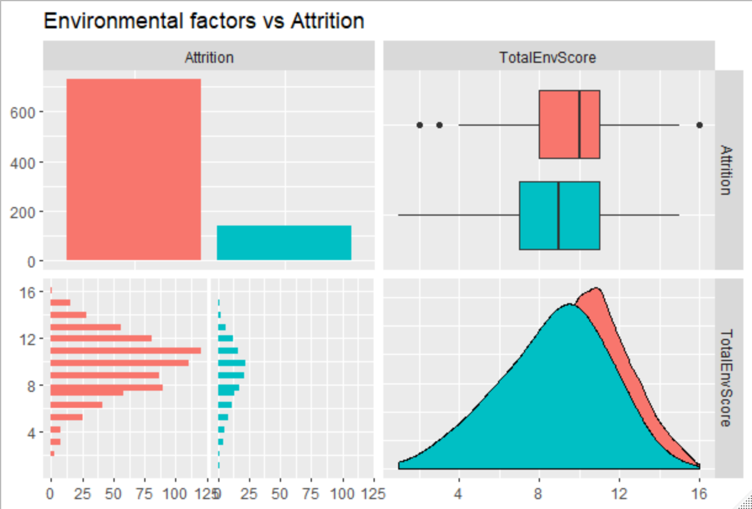
Environmental Factors

Slide 7
Why do people leave a company?
Unfair Pay or Benefits
How fair does the employee feel they are being paid? (HourlyRate, JobLevel)
How substantial are pay raises? (PercentSalaryHike)
What other benefits are included? (StockOptionLevel)
Compensation Score
The pay score is a 0 – 10000 score that gauges the level the employee feels they are being compensated.

Slide 8
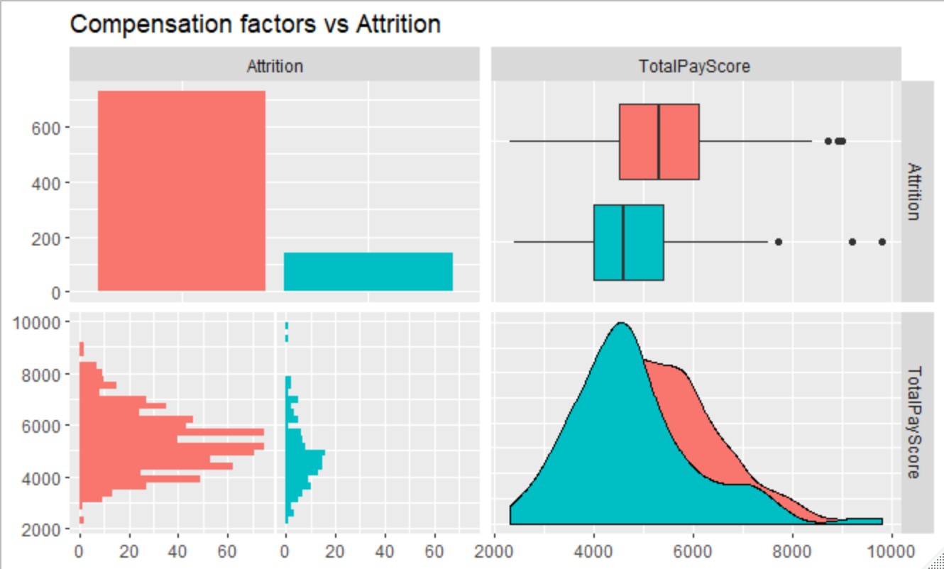
Compensation Factors

Slide 9
Why do people leave a company?
Lack of Career Growth and / or Advancement
Has the company provided training? (TrainingTimesLastYear,JobLevel)
How long since the employee’s last promotion? (YearsSinceLastPromotion, YearsAtCompany, JobLevel)
Has the employee been able to switch positions? (YearsInCurrentRole, YearsAtCompany, JobLevel)
Growth Score
The Growth Score takes into account training, Job Level, Years Since Last Promotion, Years in current role, and Years At the company. The score adjusts for the job level and years at the company, for the base metrics.

Slide 10
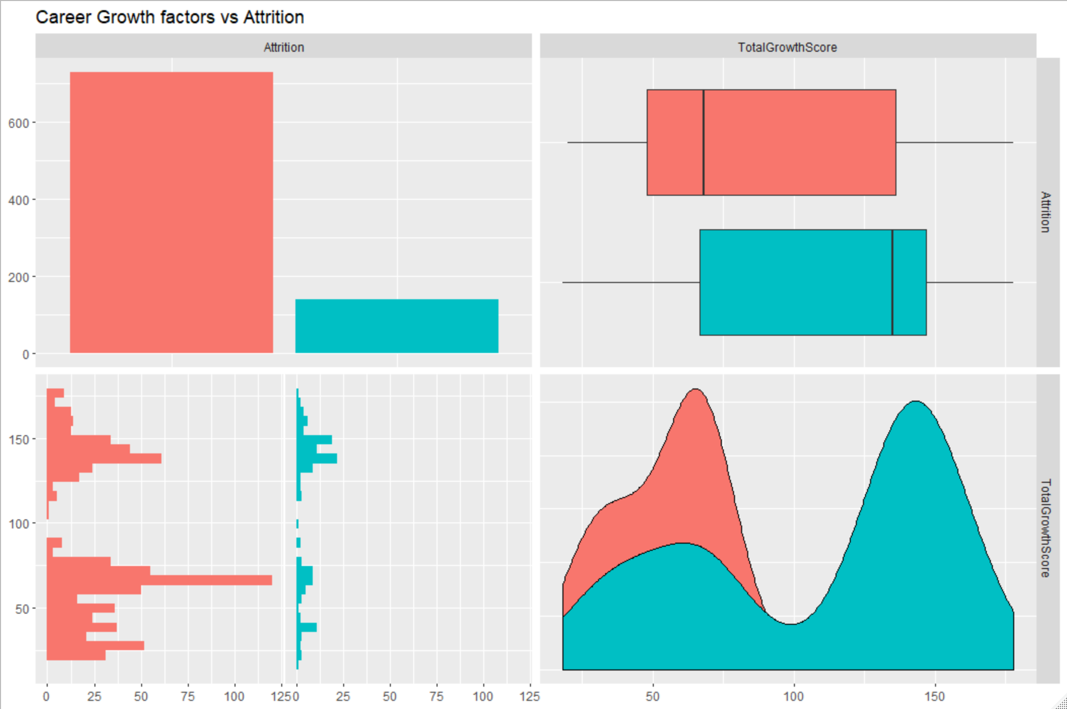
Career Growth Factors

Slide 11
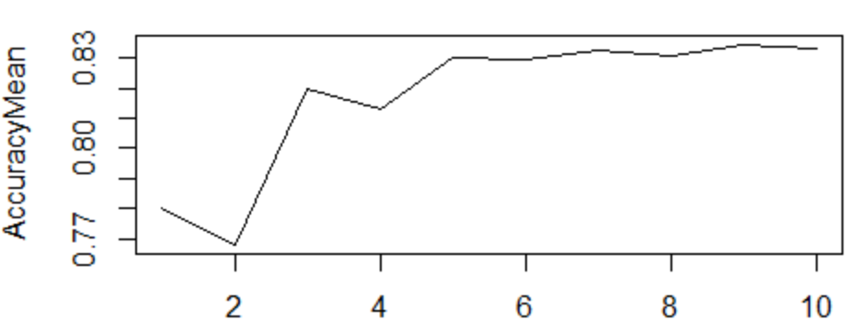
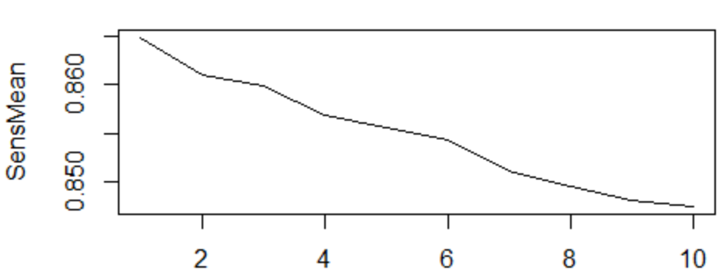
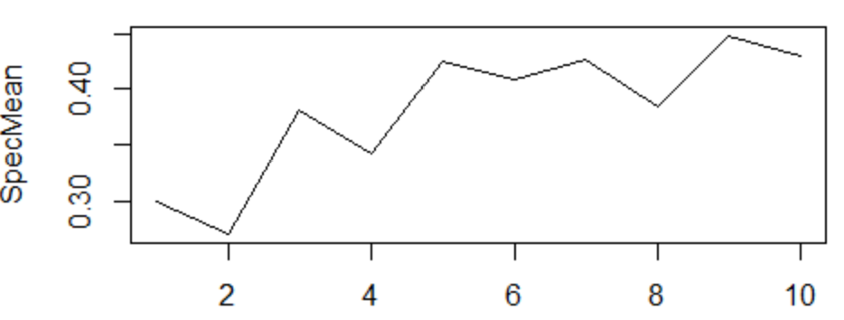
Predicting Attrition
KNN Model
KNN is the number of nearest neighbors model.
Tested 6 iterations of KNN models with different factors on a 70 / 30 split of the data.
Tested 100 iterations for best fit K values.
Choose value of 9 for best fit.
I was able to achieve :
Accuracy = 83.9
Sensitivity = 85.3
Specificity = 44.0
Features used :
Age
Marital Status
Work Life Balance Score
Environment Score
* Variables created from multiple other variables included in the data set.

Slide 12
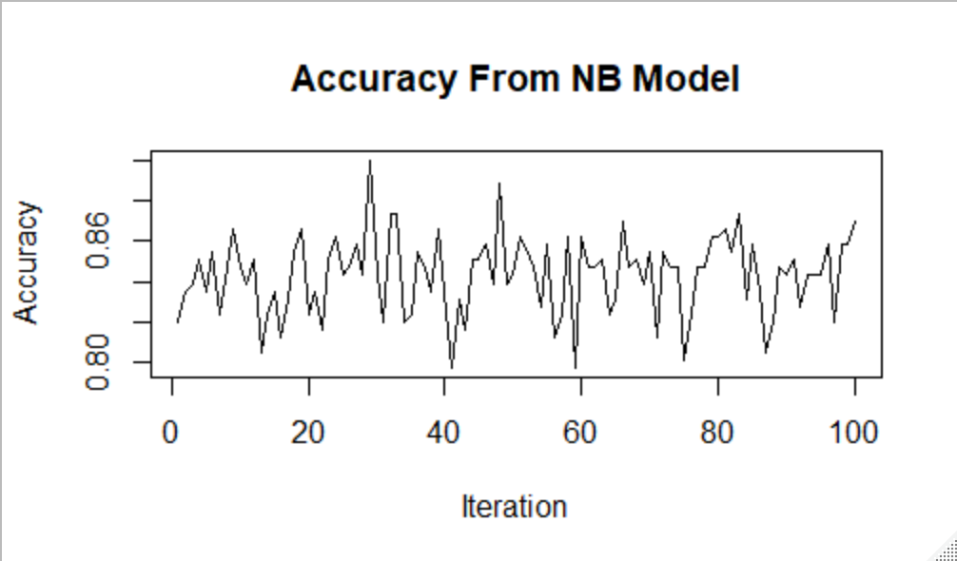
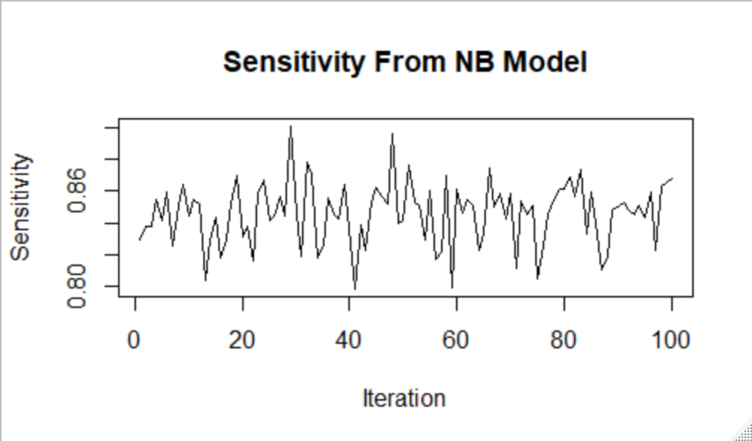
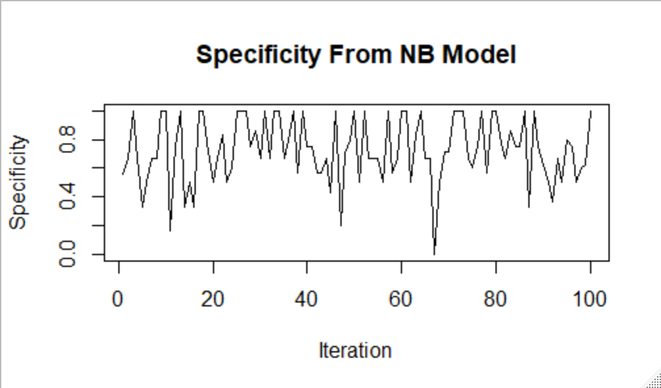
Predicting Attrition
Naïve Bayes Model
Naïve Bayes is a model that uses probabilities to classify or predict outcomes based on features or inputs.
Tested 12 different models using different features.
Tested 100 iterations using a 70/30 split
I was able to achieve :
Accuracy = 84.7
Sensitivity = 85.1
Specificity = 71.1
Features used :
Age
Marital Status
Work Life Balance Score
Environment Score
* Variables created from multiple other variables included in the data set.

Slide 13
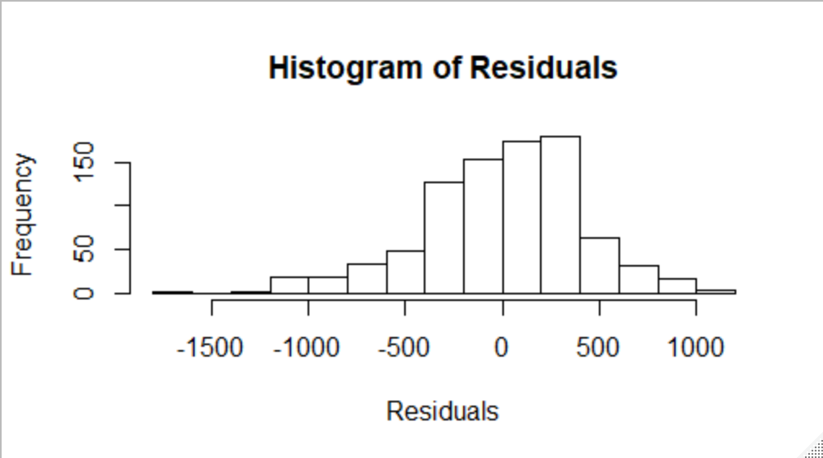
Predicting Monthly Income
Linear Regression Model
Linear Regression predicts a dependent variable based on one or more independent variables.
16 different variable combinations.
100 iterations using a leave one out method.
I was able to achieve :
RSME (Root Mean Squared Error) value of 440.33
Variables used in this model :
Job Level
Job Role
Years at Company
Pay Score*
Role Score*
* Variables created from multiple other variables included in the data set.

Slide 14

SUMMARY
How can we mitigate Attrition?
Provide a normal workload with minimal travel.
Make sure the employee feels challenged and satisfied in their work.
Provide fair and adequate compensation.
Provide career growth and advancement opportunities.

Slide 15

THANK YOU!
Marc Carter

